Slide 1

Entrepreneurship: Successfully Launching New Ventures
Sixth Edition
Chapter 9
Building a New-Venture Team
Notes:
If this PowerPoint presentation contains mathematical equations, you may need to check that your computer has the following installed:
1) MathType Plugin
2) Math Player (free versions available)
3) NVDA Reader (free versions available)

Slide 2
Learning Objectives
9.1 Explain the concept called liability of newness.
9.2 Describe a new-venture team and discuss the primary elements that form such a team.
9.3 Identify professional advisers and explain their role with a new-venture team.
9.4 Explain why a new-venture team might use consultants to obtain advice.

Slide 3
New-Venture Team
New-Venture Team
Is the group of founders, key employees, and advisors that move a new venture from an idea to a fully functioning firm.
Usually, the team doesn’t come together all at once. Instead, it is built as the new firm can afford to hire additional personnel.
The team also involves more than paid employees.
Many firms have boards of directors, boards of advisors, and professionals on whom they rely for direction and advice.

Slide 4
Liability of Newness
New ventures have a high propensity to fail.
The high failure rate is due in part to the liability of newness, which refers to the fact that new companies often falter because the people involved can’t adjust fast enough to their new roles and because the firm lacks a track record of success.
Assembling a talented and experienced management team is one path that firms can take to overcome these limitations.

Slide 5
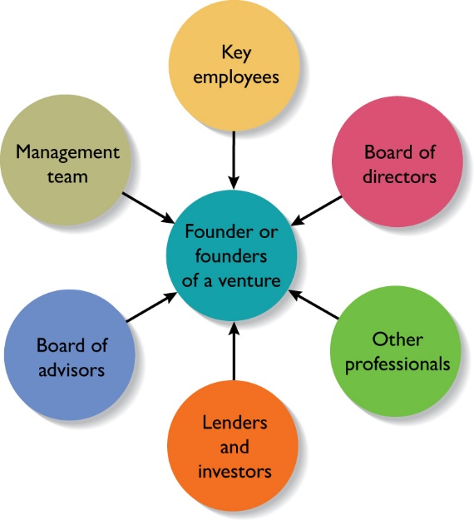
Separate Elements of a New-Venture Team
Figure 9.1 Elements of a New-Venture Team

Slide 6
Common Mistakes in Putting Together a New-Venture Team (1 of 2)
Placing unqualified friends or family members in management positions.
Assuming that previous success in other industries automatically translates to your venture’s industry.
Presenting a “one person team” philosophy—meaning that one person (or a small group of people) is wearing all hats with no plans to bolster the team.
Hiring top managers without sharing ownership in the firm.

Slide 7
Common Mistakes in Putting Together a New-Venture Team (2 of 2)
Not disclosing or talking dismissively of management team skill or competency gaps.
Vague or unclear plans for filling the skill or competency gaps that clearly exist.

Slide 8
The Founder or Founders of a New-Venture
Founder or Founders
The characteristics of the founder or founders of a firm and their early decisions have a significant impact on the manner in which the new-venture team takes shape.
Size of the Founding Team
Studies have shown that 50% to 70% of all new ventures are started by more than one individual.
Experts disagree about whether new ventures started by a team have an advantage over those started by a sole entrepreneur.

Slide 9
Advantages and Disadvantages of Starting a Venture as a Team (1 of 2)
Advantages
Teams bring more talent, resources, and ideas to a new venture.
Teams bring a broader and deeper network of social and professional contacts to a new business.
The psychological support that the cofounders of a business can offer one another can be an important element of a new venture’s success.

Slide 10
Advantages and Disadvantages of Starting a Venture as a Team (2 of 2)
Disadvantages
Team members may not get along.
If two or more people start a firm as “equals,” conflicts can arise when the firm needs to establish a formal structure and designate one person as the CEO.
If the founders have similar areas of expertise, they may duplicate rather than complement one another.
Team members can easily disagree in terms of work habits, tolerances for risk, levels of passion for the business, ideas on how the business should be run, and similar key issues.

Slide 11
Key Elements of a Successful Founding Team
Teams that have worked together before, as opposed to teams that are working together for the first time, have an edge.
The members of the team are heterogeneous, meaning that they are diverse in terms of their abilities and experiences, rather than homogeneous, meaning that their areas of expertise are very similar to one another.
The team is not too big.
A founding team can be too big, causing communications problems and an increased potential for conflict.
The sweet spot is two to three founders.

Slide 12
Preferred Attributes of Sole Entrepreneurs and Members of a New-Venture Team (1 of 2)
Higher Education
Evidence suggest that important entrepreneurial skills are enhanced through higher education.
Prior Entrepreneurial Experience
Founders familiar with the entrepreneurial process are more likely to avoid costly mistakes than founders without similar experience.

Slide 13
Preferred Attributes of Sole Entrepreneurs and Members of a New-Venture Team (2 of 2)
Relevant Industry Experience
Founders with relevant industry experience are more likely to have:
Better established professional networks.
More applicable marketing and management skills.
Broad Social and Professional Network
Founders with broad social and professional networks have potential access to additional know-how, capital, and customer referrals.

Slide 14
The Management Team and Key Employees
Start-ups vary in terms of how quickly they need to add personnel.
In some instances, the founders will work alone for a period of time. In other instances, employees are hired immediately.
A skills profile is a chart that depicts the most important skills that are needed and where skills gaps exist in a new firm.

Slide 15
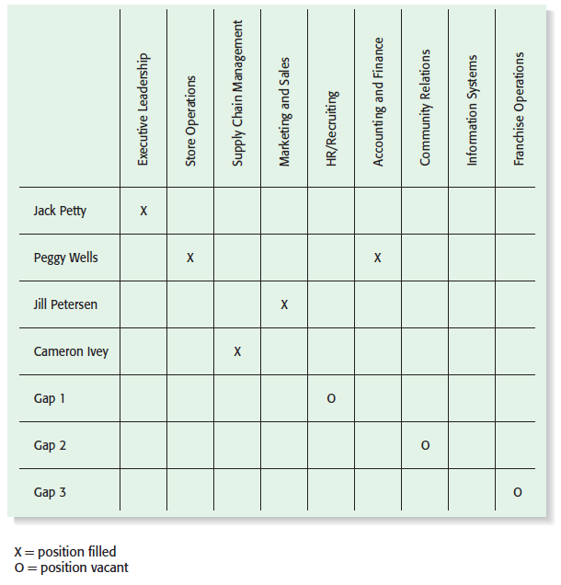
Skills Profile for New Venture Fitness Drinks
Figure 9.2 Skills Profile for New Venture Fitness Drinks

Slide 16
Sources of Labor New Ventures Utilize to Get Their Work Done (1 of 2)
Full-or Part-time Employee
Someone who works for a business, at the business’s location, utilizing the business’s tools and equipment and according to the business’s policies and procedures.
Intern
An intern is a person who works for a business as an apprentice or trainee for the purpose of obtaining practical experience.

Slide 17
Sources of Labor New Ventures Utilize to Get Their Work Done (2 of 2)
Freelancer (or contractor)
A person who is in business for themselves, works on their own time with their own tools and equipment, and performs services for a number of different clients.
Virtual Assistant
A freelancer who provides administrative, technical, or creative assistance to clients remotely from a home office.

Slide 18
The Roles of the Board of Directors (1 of 2)
Board of Directors
If a new venture organizes as a corporation, it is legally required to have a board of directors.
A board of directors is a panel of individuals who are elected by a corporation’s shareholders to oversee the management of the firm.
A board is typically made up of both inside directors and outside directors.
An inside director is a person who is also an officer of the firm.
An outside director is someone who is not employed by the firm.

Slide 19
The Roles of the Board of Directors (2 of 2)
Formal Responsibility of the Board
A board of directors has three formal responsibilities.
Appoint the officers of the firm.
Declare dividends.
Oversee the affairs of the corporation.
Frequency of Meetings and Compensation
Most boards of directors meet three to four times a year.
New ventures are more likely to pay their board members in company stock or ask them to serve on a voluntary basis rather than pay a cash honorarium.

Slide 20
What a Board of Directors Can Do to Help a Start-Up Get Off to a Good Start
Function | Importance of Function
Provide Guidance | Although a board of directors has formal governance responsibilities, its most useful role is to provide guidance and support to the firm’s managers.
Lend Legitimacy | Another function of a board of directors is to lend legitimacy to a firm. Well-known and respected board members bring instant credibility to a firm.

Slide 21
Rounding out the Team: The Role of Professional Advisers
Board of Advisors
Lenders and Investors
Other Professionals

Slide 22
Board of Advisors (1 of 3)
Board of Advisors
A board of advisors is a panel of experts who are asked by a firm’s managers to provide counsel and advice on an ongoing basis.
Unlike a board of directors, a board of advisors possesses no legal responsibility for the firm and gives nonbinding advice.
An advisory board can be established for general purposes or can be set up to address a specific issue or need.

Slide 23
Board of Advisors (2 of 3)
Many people are more willing to serve on a company’s board of advisors than its board of directors because it requires less time and there is no potential legal liability involved.
Like the members of a board of directors, the members of a company’s board of advisors provide guidance and lend credibility to the firm.

Slide 24
Board of Advisors (3 of 3)
Guidelines to Organizing a Board of Advisors
A board of advisors should not be organized just so a company can boast of it. Advisors will become disillusioned if they don’t play a meaningful role in the firm’s development and growth.
A firm should look for board members who are compatible and complement one another in terms of experience and expertise.
When inviting people to serve on its board of advisors, a company should carefully spell out to the individuals involved the rules in terms of access to confidential information.

Slide 25
Lenders and Investors
Lenders and Investors
Lenders and investors have a vested interest in the companies they finance, often causing them to become very involved in helping the firms they fund.
Like the other non-employee members of a firm’s new-venture team, lenders and investors help new firms by providing guidance and lending advice.
In addition, a firm’s lenders and investors assume the natural role of providing financial oversight.

Slide 26
Ways Lenders and Investors Add Value to an Entrepreneurial Firm (1 of 2)
Help identify and recruit key management personnel.
Provide insight into the industry and markets in which the venture intends to participate.
Help the venture fine-tune its business model.
Serve as a sounding board for new ideas.
Provide introductions to additional sources of capital.
Recruit customers.

Slide 27
Ways Lenders and Investors Add Value to an Entrepreneurial Firm (2 of 2)
Help to arrange business partnerships.
Serve on the venture’s board of directors or board of advisors.
Provide a sense of calm in the midst of the emotional roller-coaster that many new-venture teams experience.

Slide 28
Other Professionals
Other Professionals
The other professionals that make up a firm’s new-venture team include attorneys, accountants, and business consultants.
Business Consultants
A business consultant is an individual who gives professional or expert advice.
Business consultants fall into two categories: paid consultants and consultants who are available for free or at a reduced rate through a nonprofit or governmental agency.

Slide 29

Copyright

